Slide 1
Hash maps: How do they work?
Studies: Electrical Engineering
Course: System- and Softwareengineering
Semester: 5

Slide 2
Table of contents
What is a Hash algorithm?
What is a Hash-map?
Hash-map example – adding values
Hash-map example – bucket extension
Asymptotic runtime complexity (ARC) evaluation

Slide 3
Hash algorithm
Produces for a given input x0 always the same output y0
A small change on the input x0 to x1 usually creates a greatly differing output y1
Can produce for a differing input x2 the same output y0
When two differing inputs x0 and x2 create the same output y0 it is called a collision
Used for checksums, cryptography and obviously hash-maps
The purpose of these hash functions differ in their properties like speed, collision probability, …

Slide 4
Hash map
Given a map with length l
For a given input x0 the hash value gets calculated
Now we save the input in the bucket (hash value mod l)
If there is no entry yet there, perfect -> no collision
If there are a few entries there, okay -> search linear
If there are too much entries there, expand list, and copy/move every value out of their bucket into the new list as described
These are the humps in the ARC-graph

Slide 5
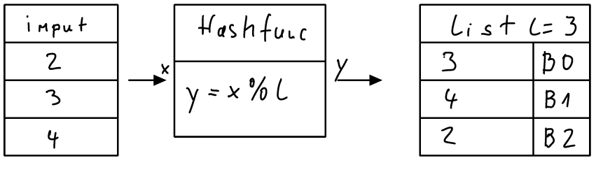
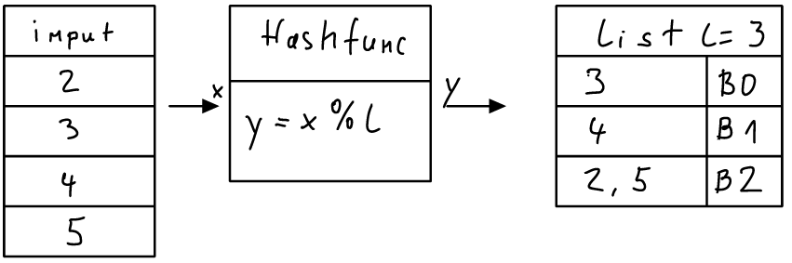
Hash map example – adding values

Slide 6
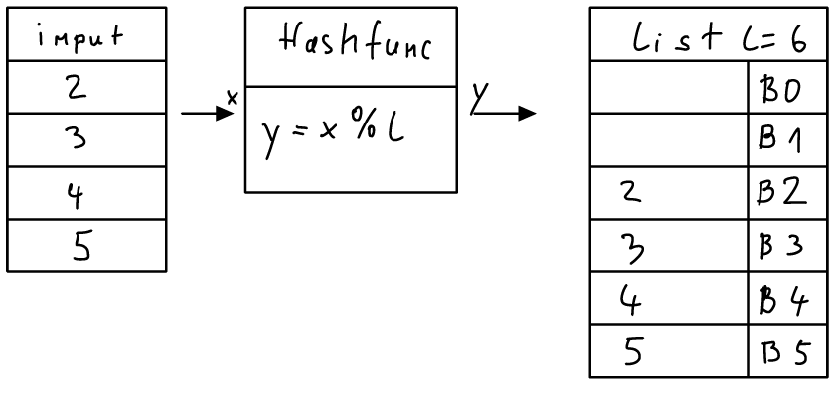
Hash map – example – bucket extension

Slide 7
Asymptotic runtime complexity evaluation
As there is no collision, we can access directly through our hash map to the bucket where the value would be or is stored
For every collision we must linearly search through the bucket with O(n) where n are the collisions in this bucket
When there are too many collisions in one bucket, we must expand the list and create more buckets to keep our promise of O(1)

Slide 8
Thank you for your attention
Name: Michael Geuze
Contact: michael.geuze@students.fhv.at

